Slide 1
Water Quality Monitoring System Using IOT
by,
krishnaja unnikrishnan
s4 B batch

Slide 2
INTRODUCTION
Water is one of the most essential natural resource that has been gifted to the mankind. But the rapid development of the society and numerous human activities speeded up the contamination and deteriorated the water resources. For above water quality monitoring is necessary to identify any changes in water quality parameters from time-to time to make sure its safety in real time.
The Central Pollution Control Board (CPCB) has established a series of monitoring stations on water bodies across the country which monitor the water quality on either monthly or yearly basis. This is done to ensure that the water quality is being maintained or restored at desired level.
Water quality monitoring systems need to quickly identify any changes in the quality of water and report the same to the officials for immediate action.

Slide 3
The conventional method of testing water quality is to gather samples of water manually and send to the lab to test and analyse. This method is time consuming, wastage of man power, and not economical.
The water quality measuring system that we have implemented checks the quality of water in real time through various sensor.
The variation in the value of this parameter points towards the presence of pollutants.
The wifi module in the system transfers data collected by the sensors to the microcontroller, and transfer the data to the smart phone/pc.

Slide 4
OBJECTIVE
The system is designed for continuous onsite sensing and real time reporting of water quality data where the officials can access the data on the smart phone/PC through Internet.

Slide 5
PROPOSED SYSTEM
Our proposed system employs use of multiple sensors to measure the parameters, measures the quality of water in real-time for effective action, and is economical, accurate, and required less manpower.

Slide 6
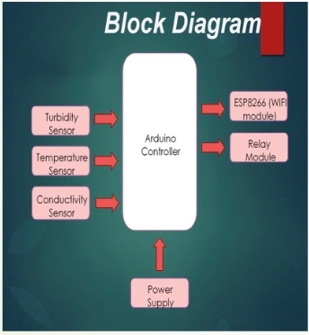
BLOCK DIAGRAM

Slide 7
COMPONENTS
Electric Conductivity Sensor
Turbidity Sensor
Temperature Sensor

Slide 8
TOOLS
FRONT END:-
Hardware and application
BACK END:-
PHP,Embedded c

Slide 9
MODULES
Data collection
Data processing
Data sending to server
User access

Slide 10
APPLICATIONS
For checking building’s water quality.
Remote area dam.
Water tank on high tower.

Slide 11
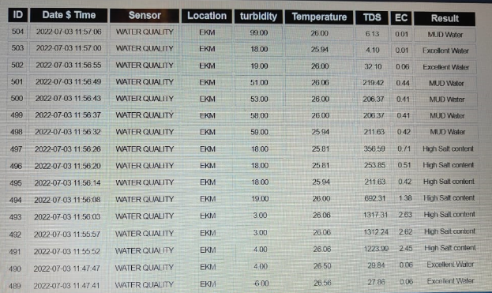

Slide 12
APPLICATION SCREENSHOT

Slide 13
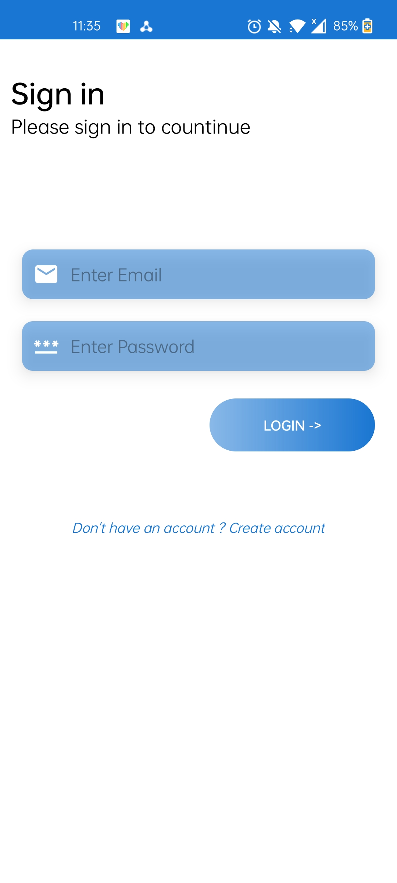
screenshots

Slide 14
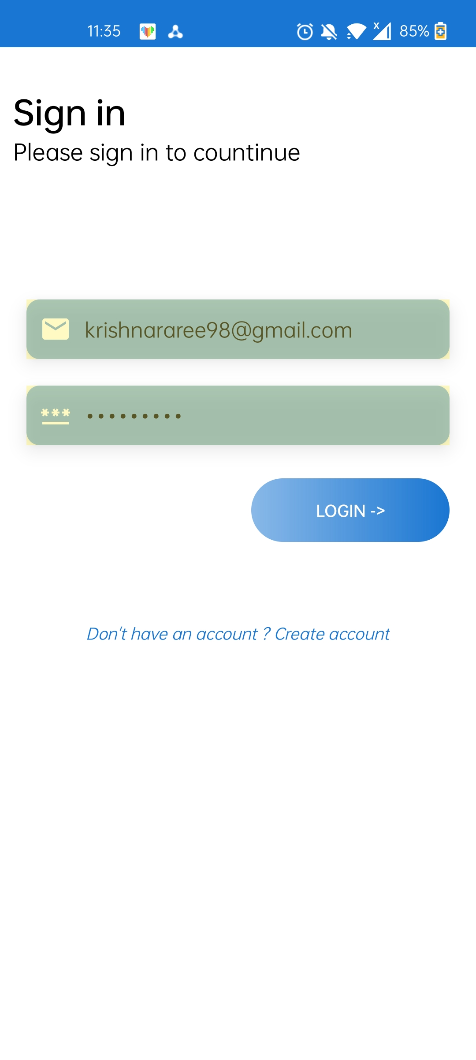

Slide 15
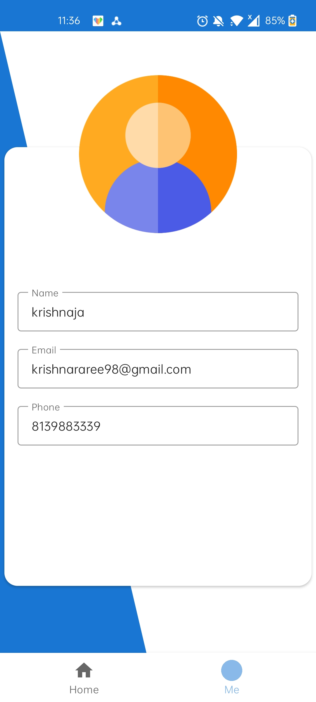

Slide 16
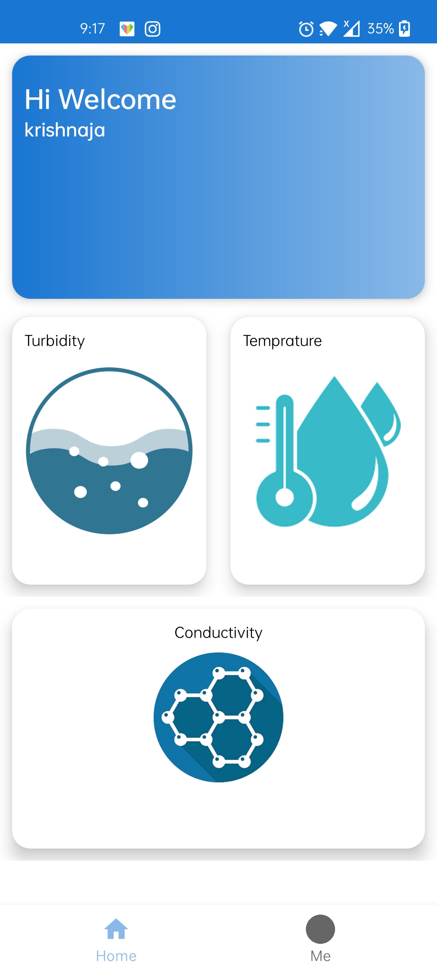

Slide 17
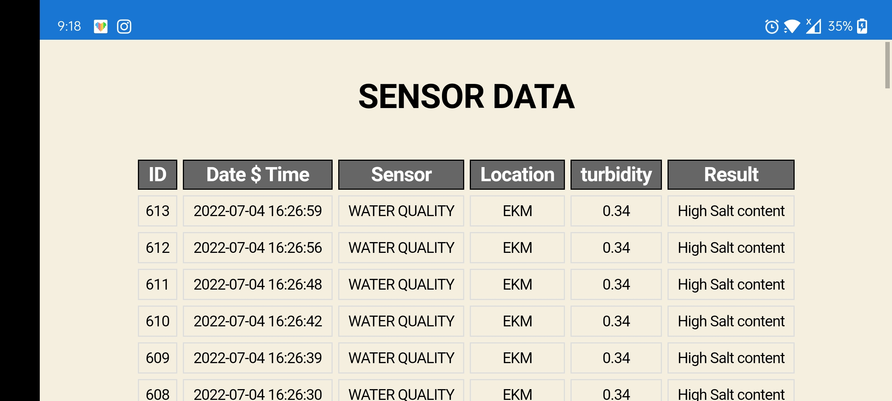

Slide 18
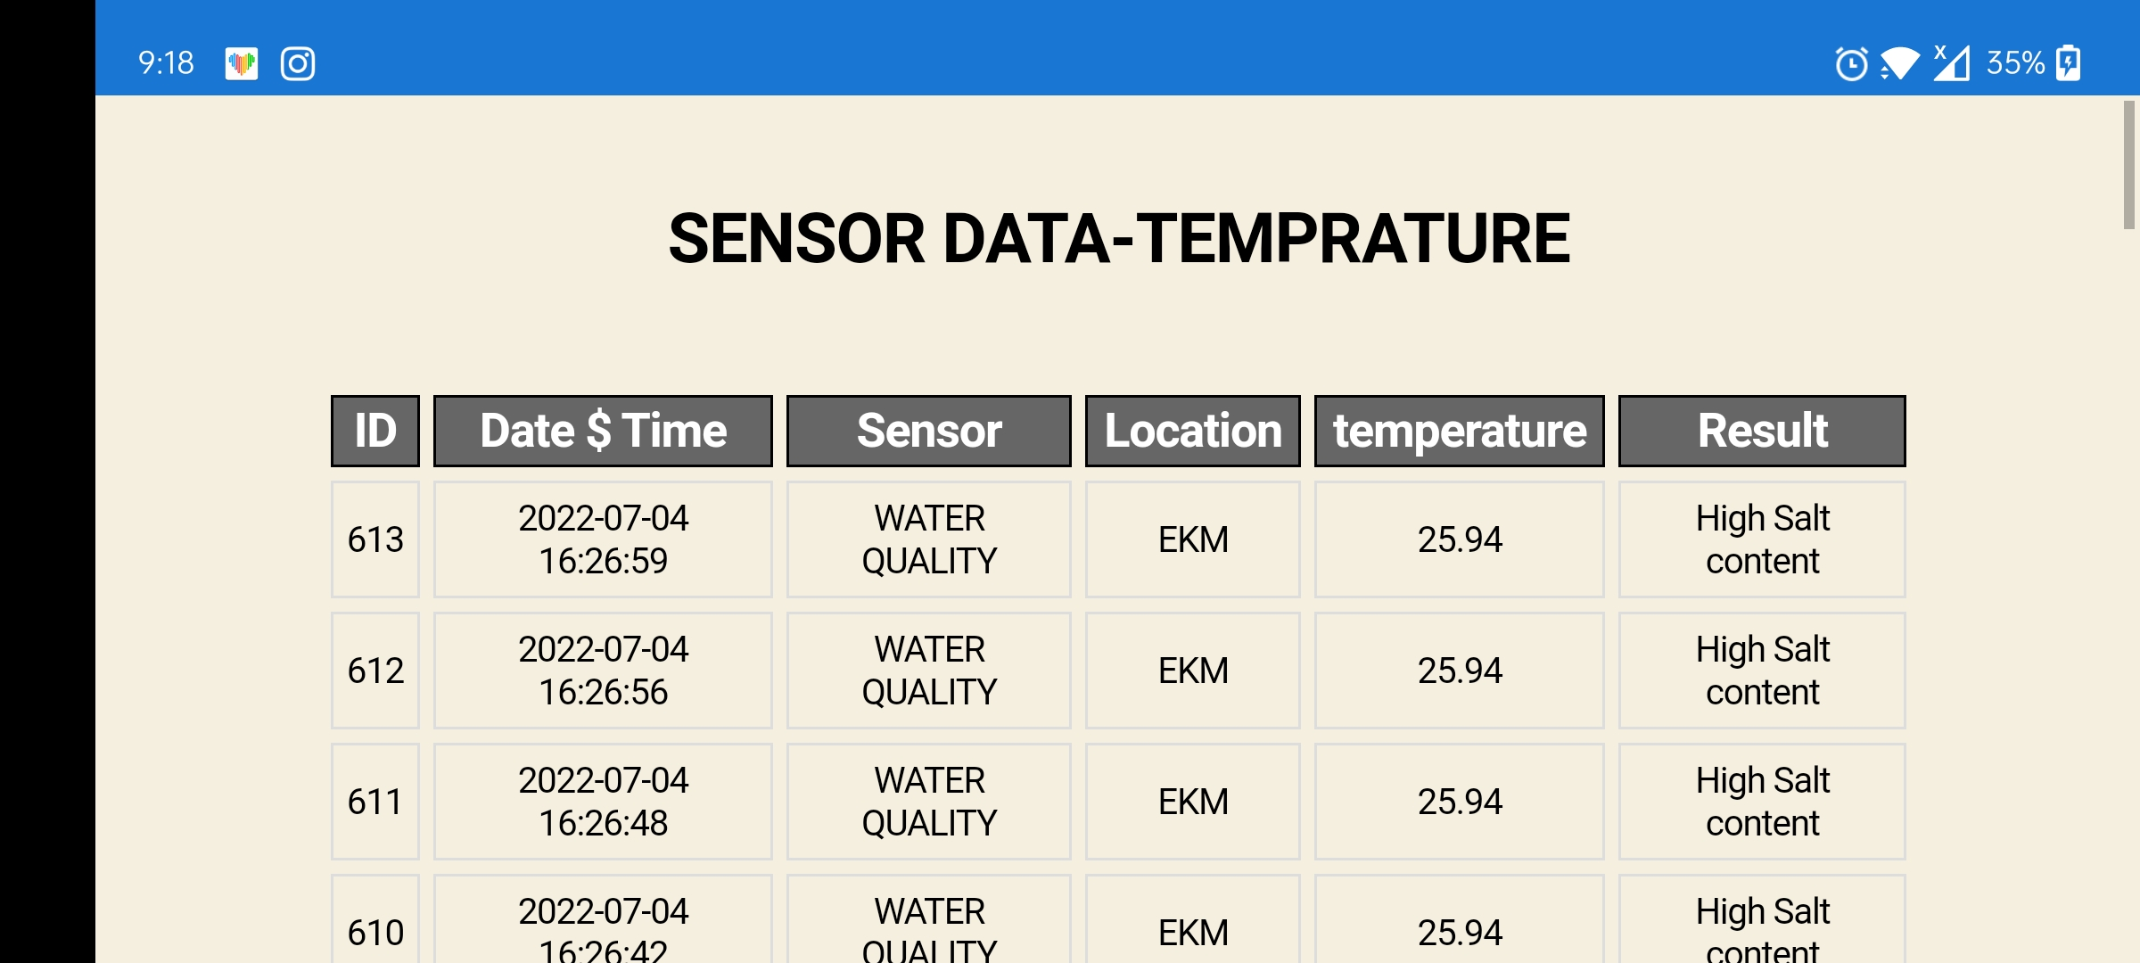

Slide 19
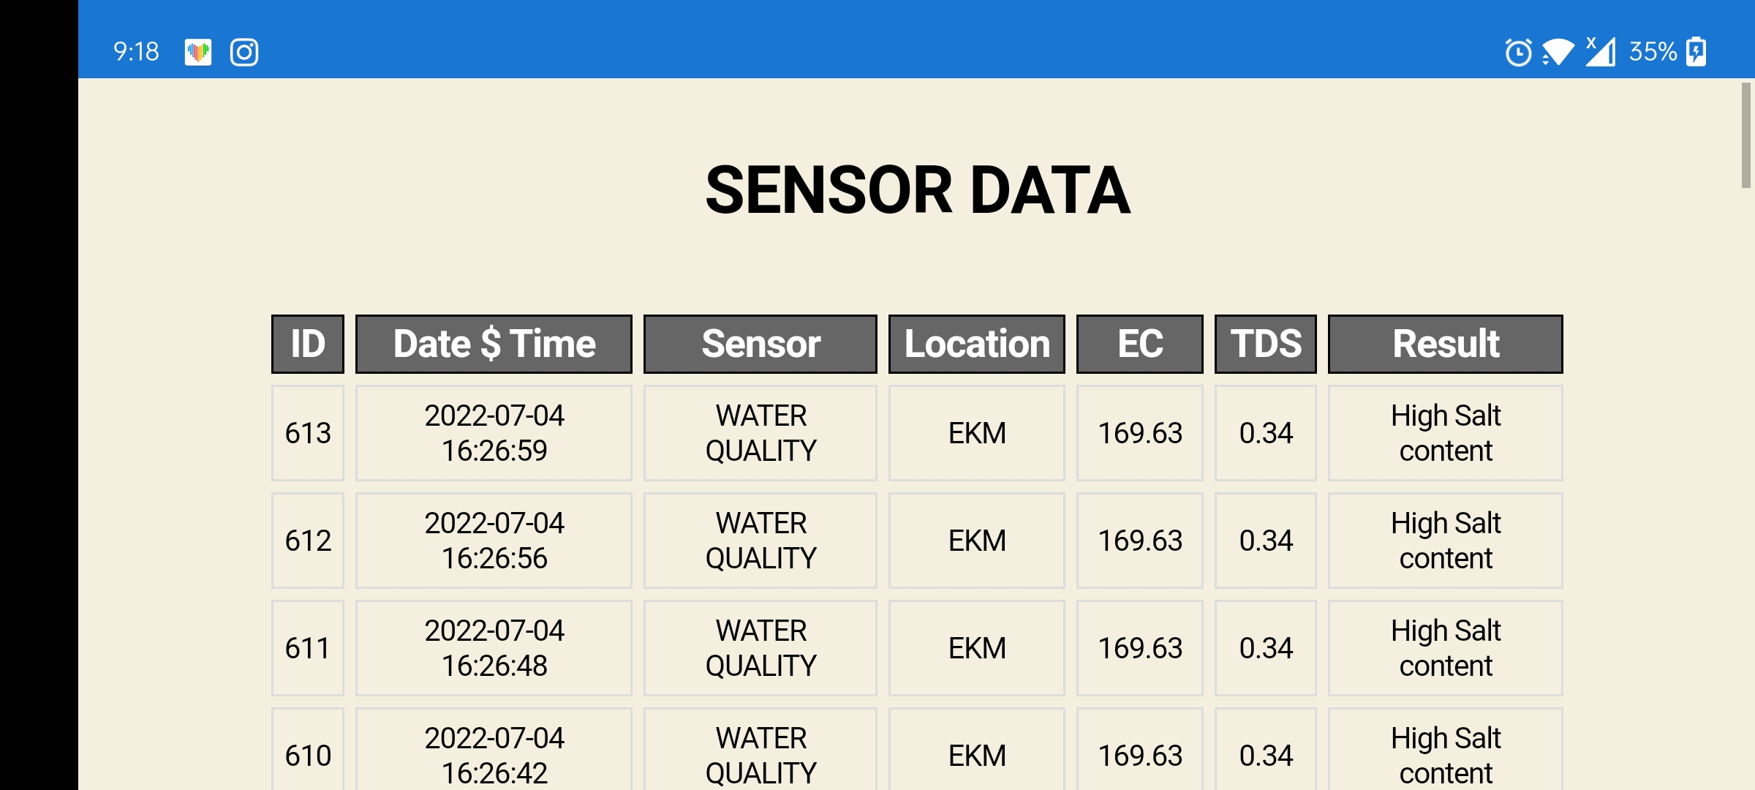

Slide 20
REFERENCE
International Journal of scientific Research in computer science for Iot based water quality monitoring system,2018
R.M. Bhardwaj,”Overview of Ganga river pollution”,Delhi 2011
“Literature survey on wireless sensor network”,University of Maryland,16 july 2003

Slide 21
THANKYOU

